Slide 1
facts
CORNER
Presented by:
Barbu Cezar
Cain Andrei
Comsa Dan
Fratila Maria
Militaru Ana

Slide 2


Did you know that…
…In Romania still exists an old glacier having the age of over 10.000 years, which can be found 16 km underground?

Slide 3
Did you know that…
…Danube , the second big river in Europe, passes through 18 cities of Romania , which means 38% of its total length and empties in the Black Sea, creating The Danube Delta, in the south-east of Romania?

Slide 4
Did you know that…
…In Romania there are plenty of thermal baths, having a very high temperature, from 20-48 degrees Celsius? Here, people can take baths during summer or winter and those who are rheumatically affected can cure their diseases faster.

Slide 5
Did you know that…
…In the Southern Carpathians, at 2040 meters height, there are a church and a hotel of ice built every year, hosting over 8000 guests per season?

Slide 6
Did you know that…
…The Danube Delta is inhabited by 5149 species of flora and fauna, which means 70% of the European wildlife? The most popular are the common and the curly pelican and the goose with the red neck.

Slide 7
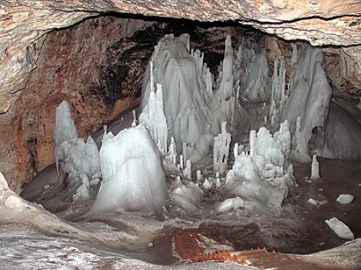

You are very smart indeed!
…and for those who didn’t know that, Scărișoara Cave is one of the biggest glaciers in the Apuseni Mountains of Romania, a part of the Carpathian chain and is considered one of the natural wonders of Romania.

Slide 8
You should know that…
…Scărișoara Cave is one of the biggest glaciers in the Apuseni Mountains of Romania, a part of the Carpathian chain and is considered one of the natural wonders of Romania.

Slide 9
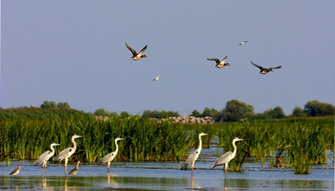
Bravo!
It seems like you know quite a lot about our country!

Slide 10
You should know that…
…Danube , the second big river in Europe, passes through 18 cities of Romania , which means 38% of its total length and empties in the Black Sea, creating The Danube Delta, in the south-east of Romania.

Slide 11
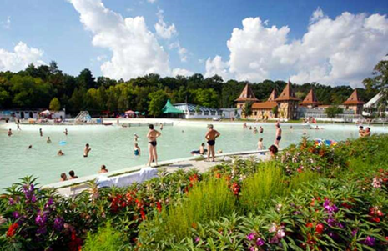
excellent!
You seem to know everything!

Slide 12
You should know that…
…In Romania there are plenty of thermal baths, having a very high temperature, from 20-48 degrees Celsius. Here, people can take baths during summer or winter and those who are rheumatically affected can cure their diseases faster.

Slide 13
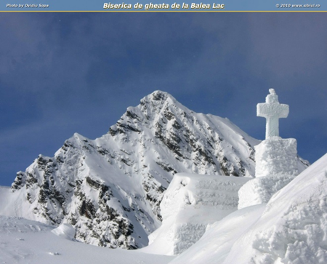
Great!
You know everything about our country!

Slide 14
You should know that…
…In the Southern Carpathians, at 2040 meters height, there are a church and a hotel of ice built every year, hosting over 8000 guests per season.

Slide 15
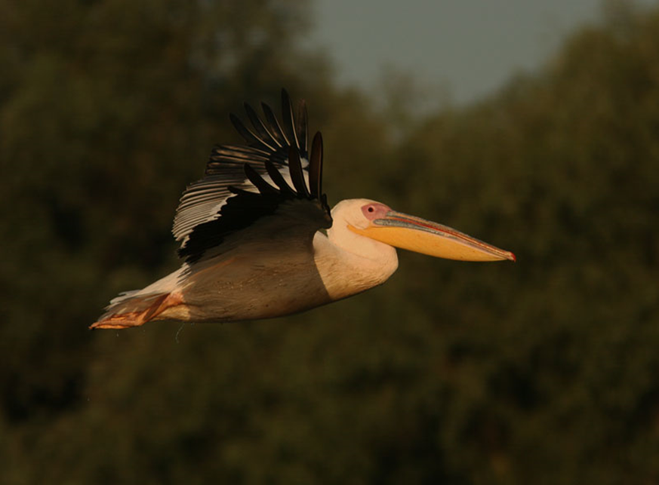
Outstanding!
You know more than we expected!

Slide 16
You should know that…
…The Danube Delta is inhabited by 5149 species of flora and fauna. The most popular are the common and the curly pelican and the goose with the red neck.

Slide 17
Thank you for your attention!
Presented by:
Barbu Cezar
Cain Andrei
Comsa Dan
Fratila Maria
Militaru Ana
Coordinated by:
Toncea Cristian
Mocanu Luminita

